Slide 1
Functions, Components, and Examples
Business Intelligence & Analytics

Slide 2
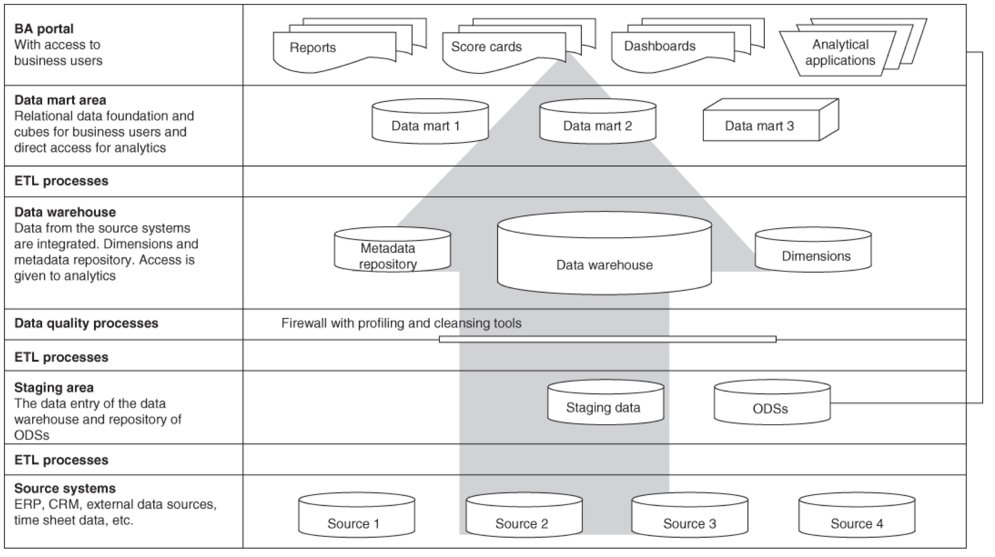

Slide 3
Definition of term
Data warehouse – the actual data tables used for reporting and analytics
Meta data repository – data describing what is in the data warehouse (more on this later)
Dimensions – a set of data attributes pertaining to something of interest to a business.
Facts – raw measurement of the business

Slide 4
examples
Facts
Sales transactions
Email sent
Consulting engagement
Marketing event
Dimensions
Customer’s name
Customer’s address
Salesperson
Location
Region
Fiscal time information (week, month, quarter)
Meta-data
Description of tables
Description of each field
Who has access
When data was accessed

Slide 5
A word about meta-data
Makes finding things in the data warehouse easier
Often there will be a search function based on the meta-data layer
Tags and labels can be added to describe what things are and how they are calculated
Increasingly will include data related to viewing patterns of data warehouse users

Slide 6
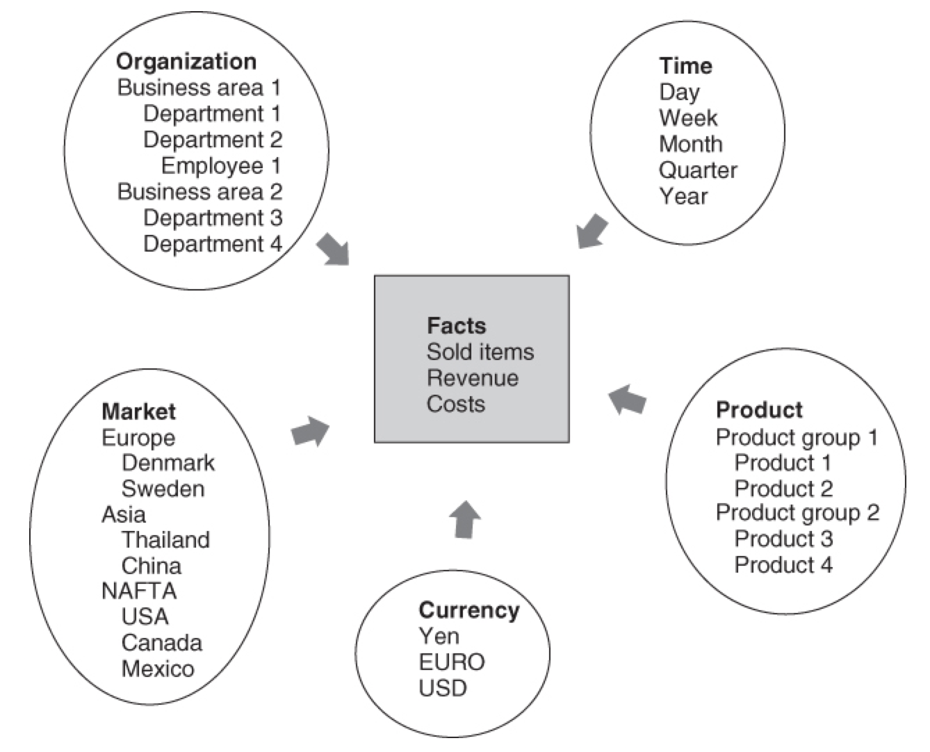
Star schema
Dimensional modeling is a popular way of organizing data (not the only way of organizing data)
Easy way of describing how facts and dimensions are related to one another
Efficiently stores data
Allows us to answer, “Why did things turn out as they did?”

Slide 8
Data mart
Specialized version of the data warehouse typically meant for a specific division or function
Many times each business unit will have assumed ownership over their data mart
Data may be stored in relational tables or in an OLAP cube
Allows the data warehouse to focus on its internal processes and not on serving reports to end users

Slide 9
Relational Data Model
Data is organized using common characteristics (star schema)
Requires the user to summarize data using SQL statements to aggregate and join data across tables
Allows for novel queries

Slide 10
Relational Data Model
Data is organized using common characteristics (star schema)
Requires the user to summarize data using SQL statements to aggregate and join data across tables
Allows for novel queries
OLAP Cube
All aggregation and other calculations carried out before data is accessed
Extraction from the cube is much faster and easier
More difficult (potentially impossible) to answer new questions
Cube size increases exponentially when dimensions are added

Slide 11
Alternative ways of storing data
Hadoop, Apache Spark, Presto
Act as more of a filesystem than a traditional database
Highly scalable, distributed system
Data typically very raw and cannot be changed
Queries can take quite a while to return data
Data might be moved into the data warehouse so it is easier and quicker to access

Slide 13
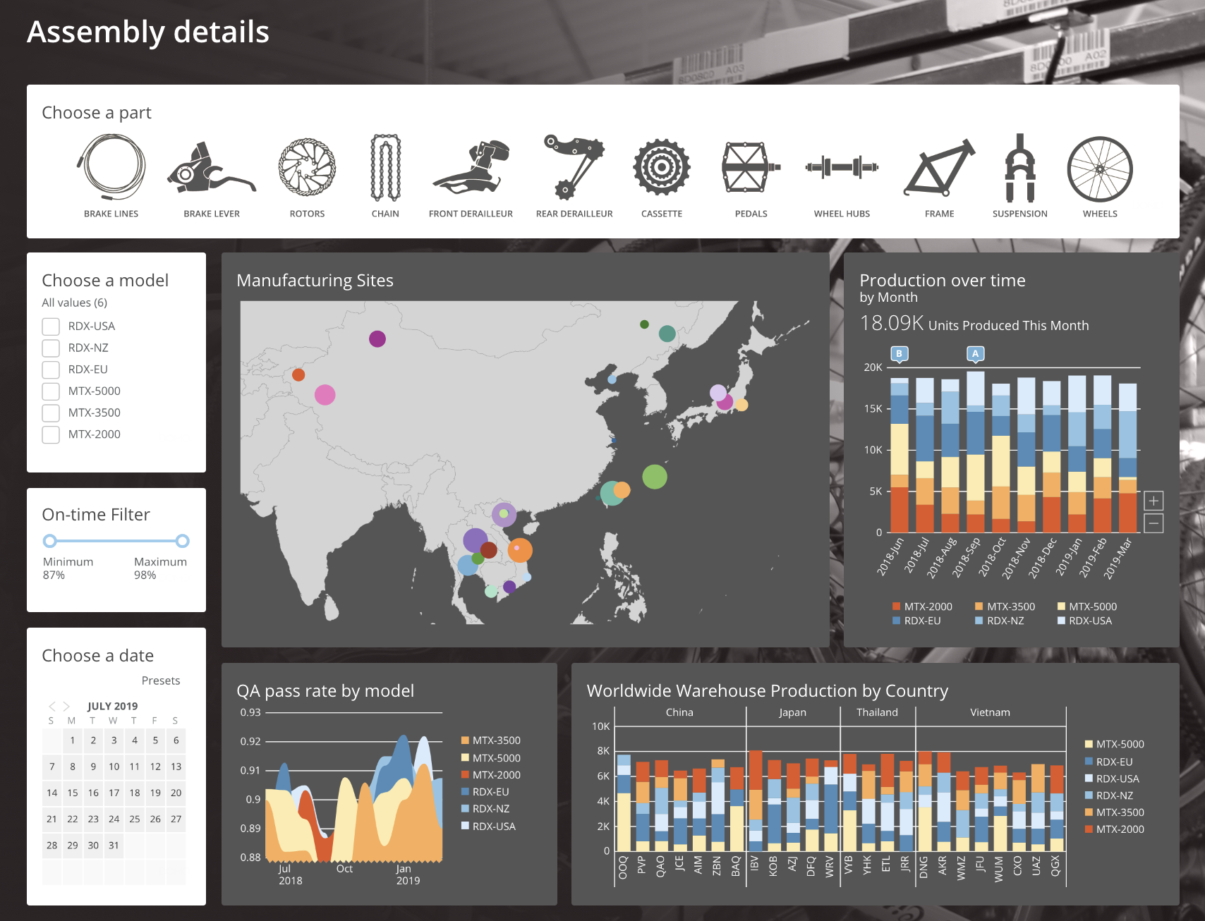
Front-end portal

Slide 14
Data structures
Different types of data
Storage methods
Data aggregation and reporting

Slide 15


